Slide 1


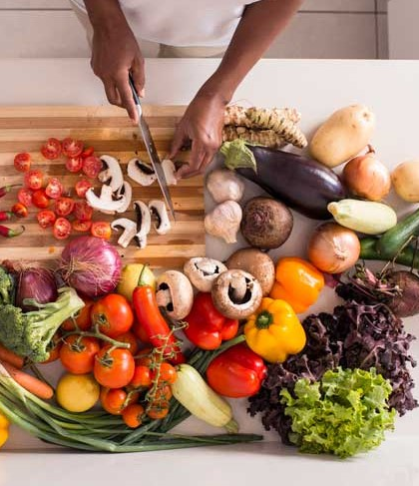

Promoting Heathy Eating and Balanced Diet
By Redefine-Me
Sprint 8
Professor: Henry Wong
Computer Science Project
Course : CS692
Team: 2 (Tiny Coders)
Designed by : Maanasa Dharini.

Slide 2
AGENDA
Team Members Roles and Responsibilities
Improvements from professor feedback
Project Description
Teamwork Agreement
Personas
Minimal Viable Product (MVP)
Technologies
Algorithm
Diagrams
Sprint 7 Recap
Product Backlog
Sprint 8 Backlog
Metrics
Retrospective
Sprint 7 Vs Sprint 8
Project Demo
Git-hub Link
Live Application Demo

Slide 3

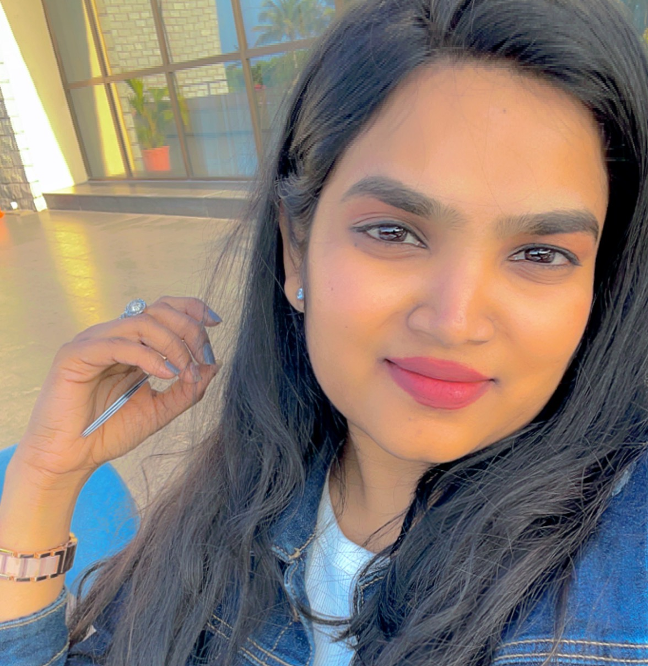
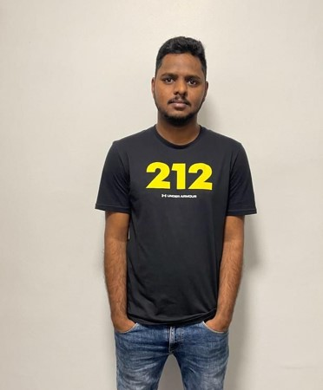
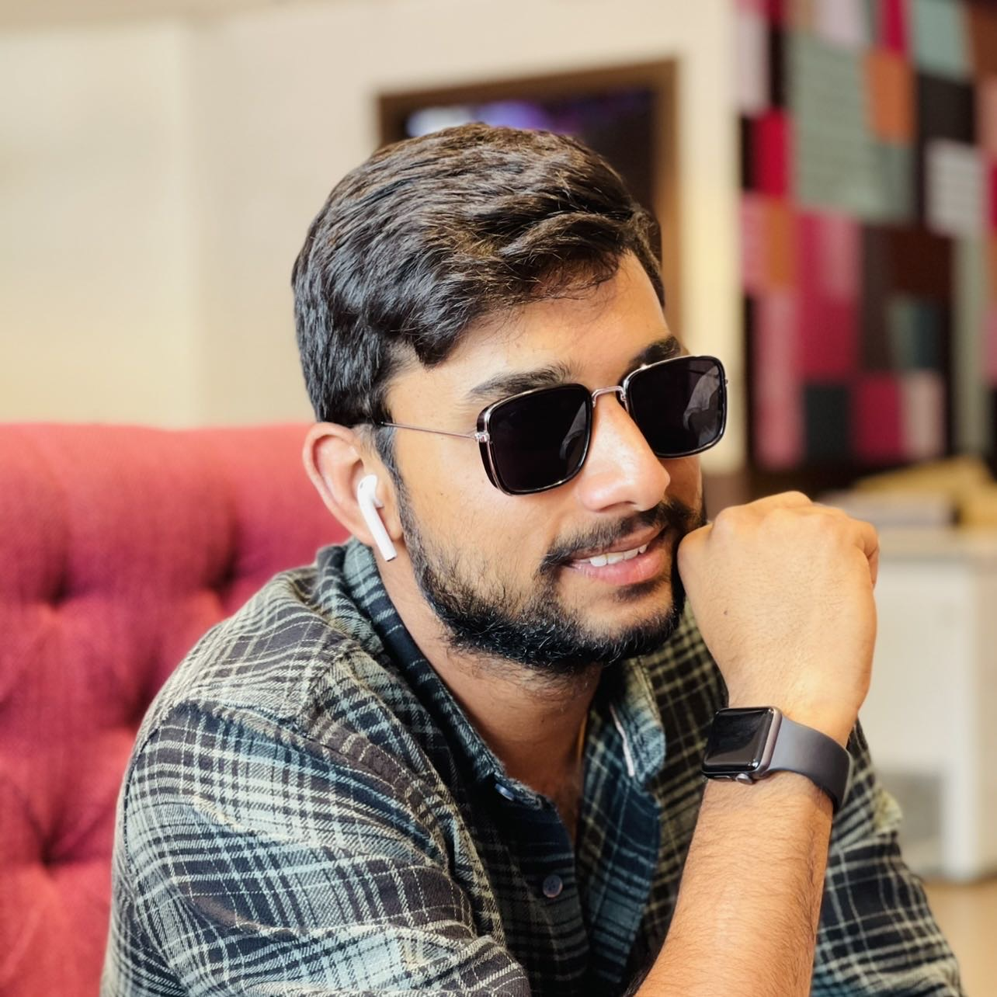

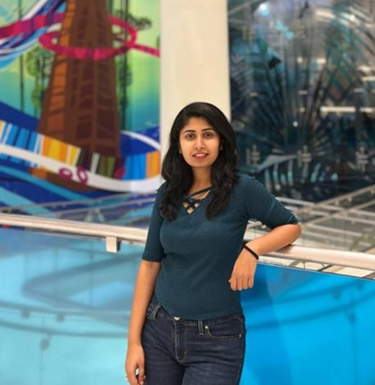
Team Member Roles
MAANASA DHARINI
DEVELOPER 1
SATHWIK MUDENTI
DEVELOPER 2
VARUN REDDY
DEVELOPER 3
NARESH BABU CHINTA
QA/TESTER
BRUNDA REDDY
DBA

Slide 4


Improvements made from Professor Feedback
Professor feedback
Improvements Made
Update all the files in the given repository
Mention criteria for the story points
Add Deployment Manual
Explain the project demo
Added all the files in the given repository
Added priority points for product backlog
Added Deployment Manual
Clearly explained project demo

Slide 5
Project description
Project Description
Project Name: | Promoting Healthy Eating and Balanced Diet with Re-Define Me.
Team Name: | Tiny Coders
Project Description: | We are providing the customers a healthy living habits with proper nutrients and workouts with unique features according to the user customization. For Customers: Who wanted to take proper medications, supplements ,diet and workouts our web application ”Re-Define Me”
Benefit Outcomes: | Customers can contact dietitian and personal trainers ones the user subscribes to the application The dietitian provides the nutrients details and the supplements to the customer without going to the hospital directly. It will provide the details of the gyms nearby and highly rated personal trainers. Customers can rate the doctor’s and the trainer’s which would help others to select them accordingly.
GitHub Wiki: | https://github.com/htmw/tiny-coder/wiki

Slide 6
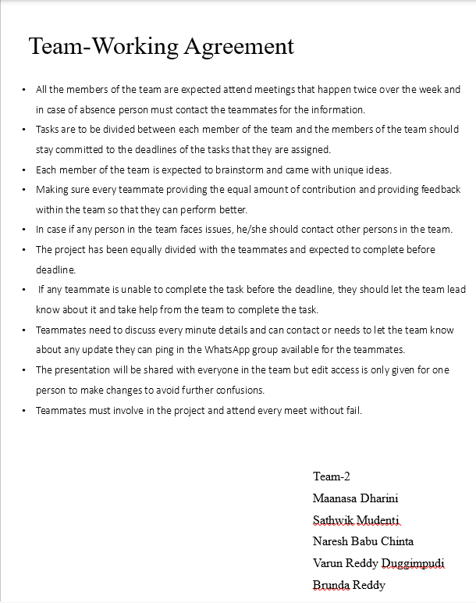
Team Working Agreement

Slide 7
PERSONAS

Slide 8
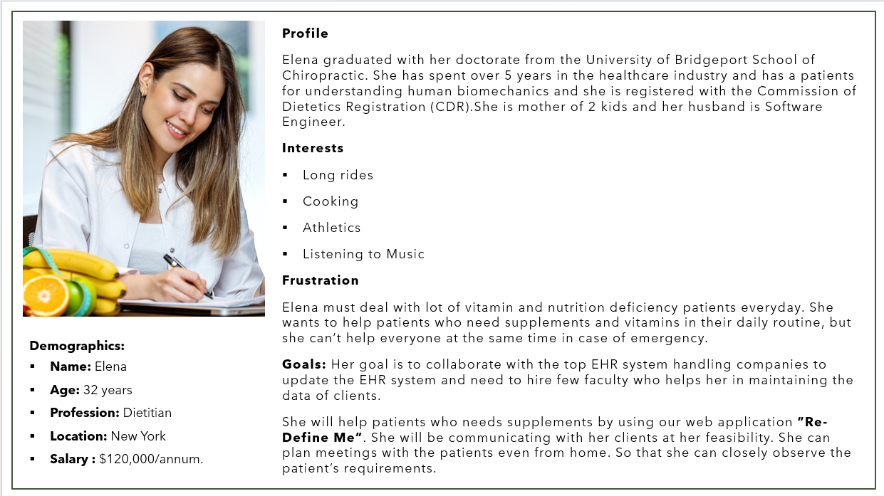

Slide 9
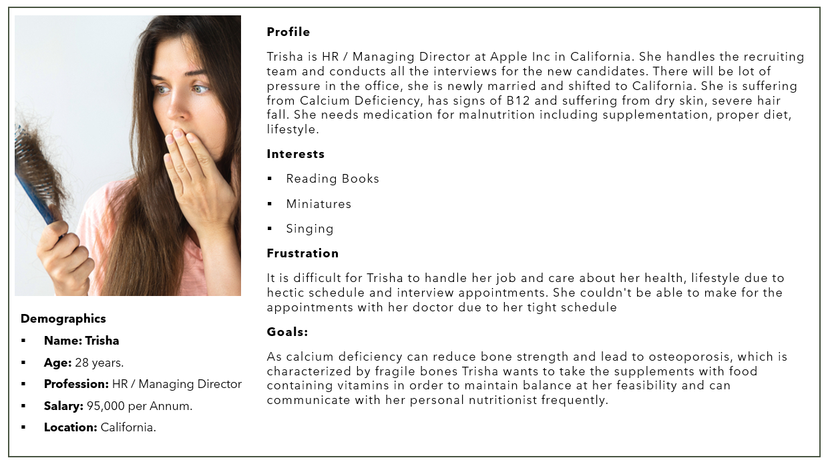

Slide 10
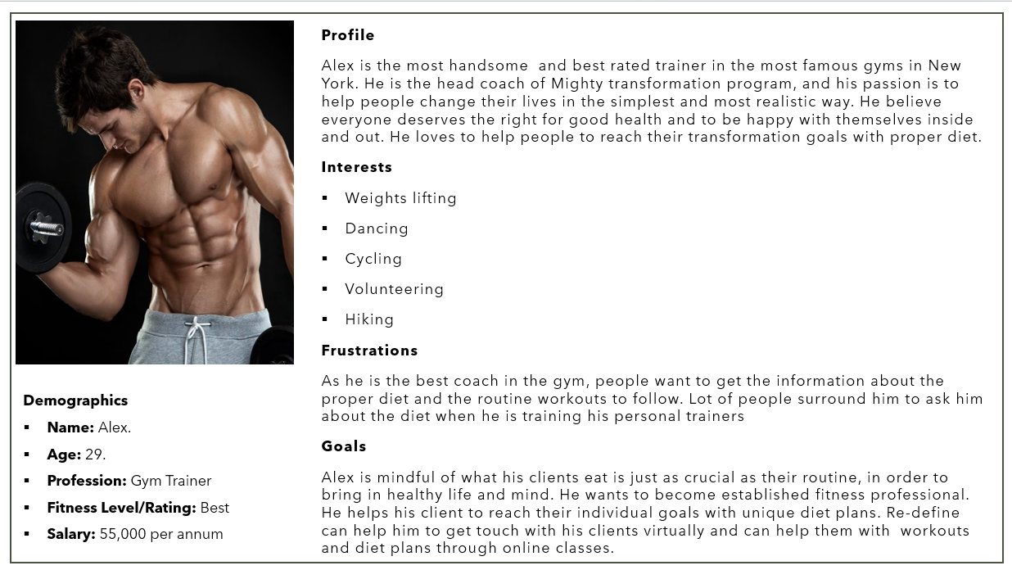

Slide 11
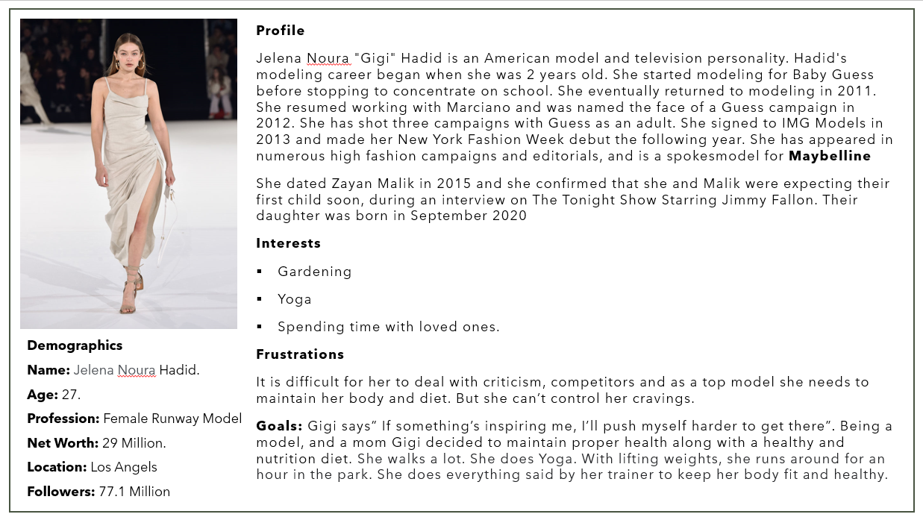

Slide 12
MVP
Home Page
Sign Up
Log In
Calorie Estimation
Calorie Calculator
Diet Plan
Experts/
Coaches
Recipes
Preparation
Ingredients
Calories
Favorites
About
Contact
Sign Out

Slide 13
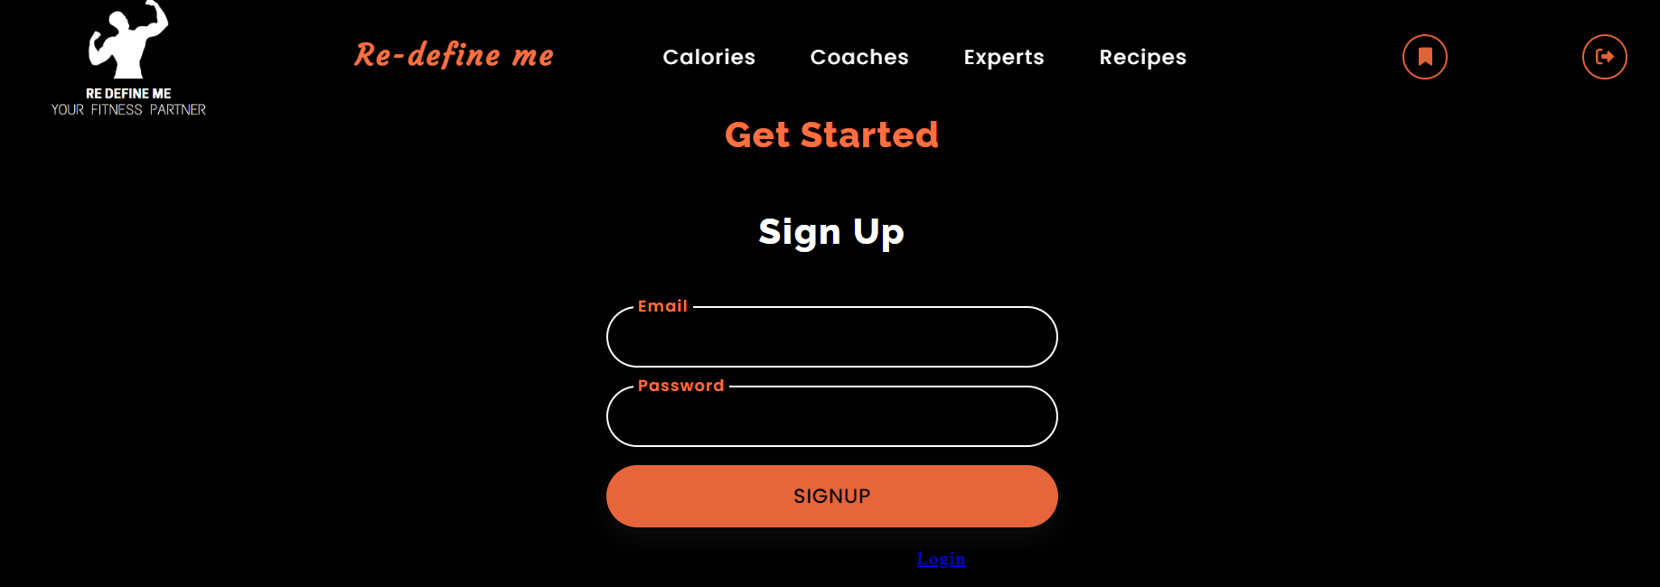
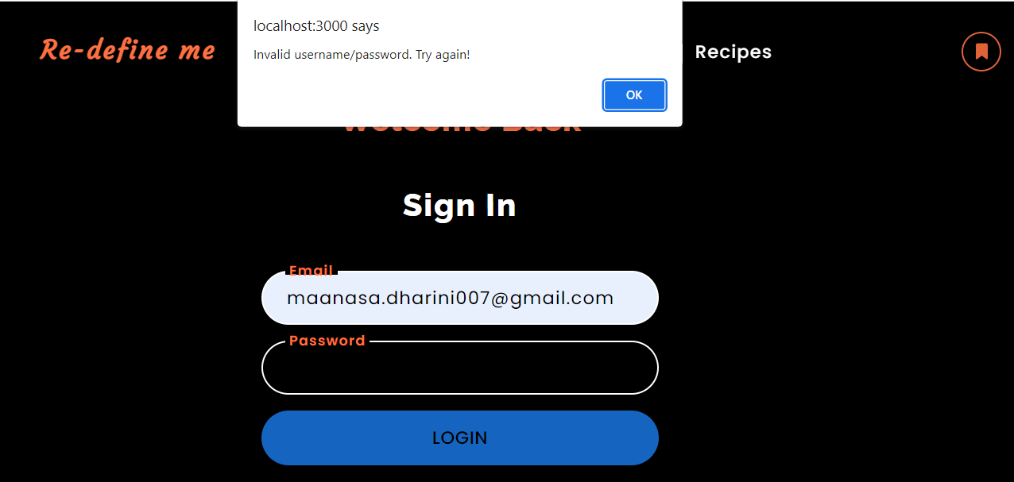
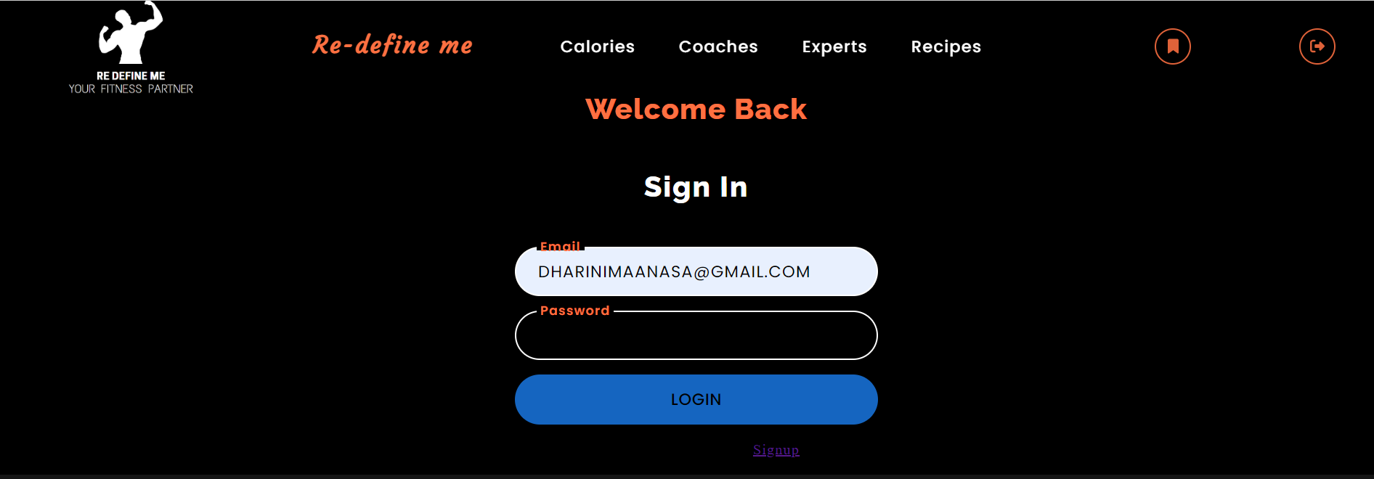

Slide 14
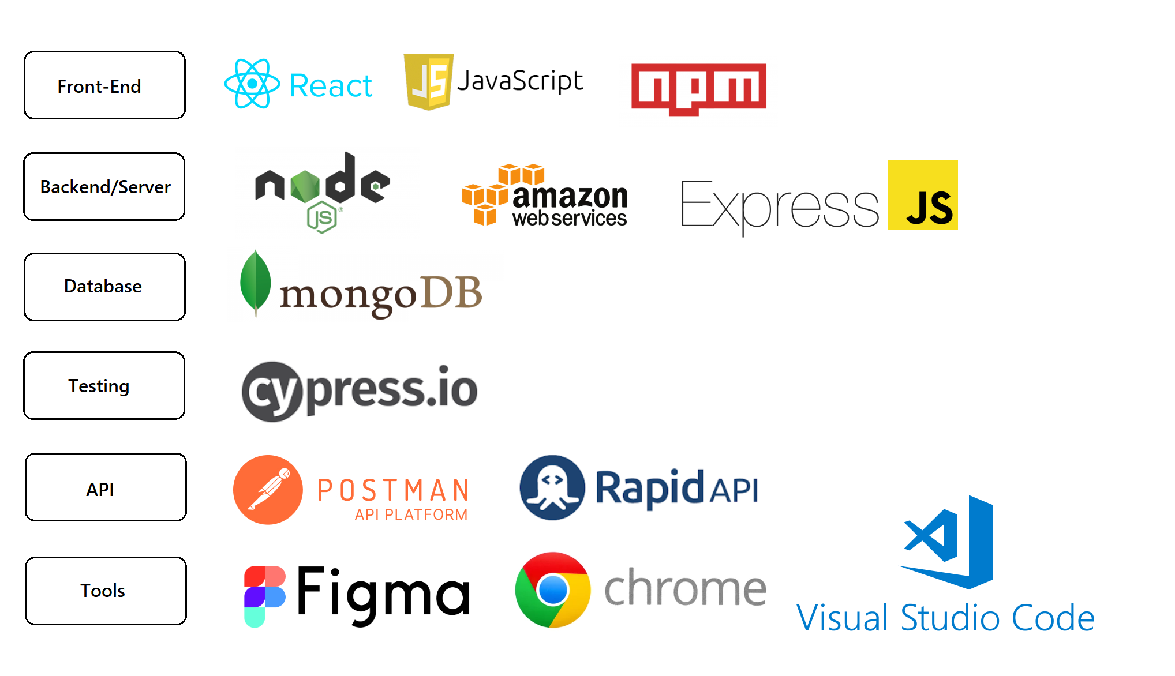
Technologies

Slide 15

Diagrams

Slide 16
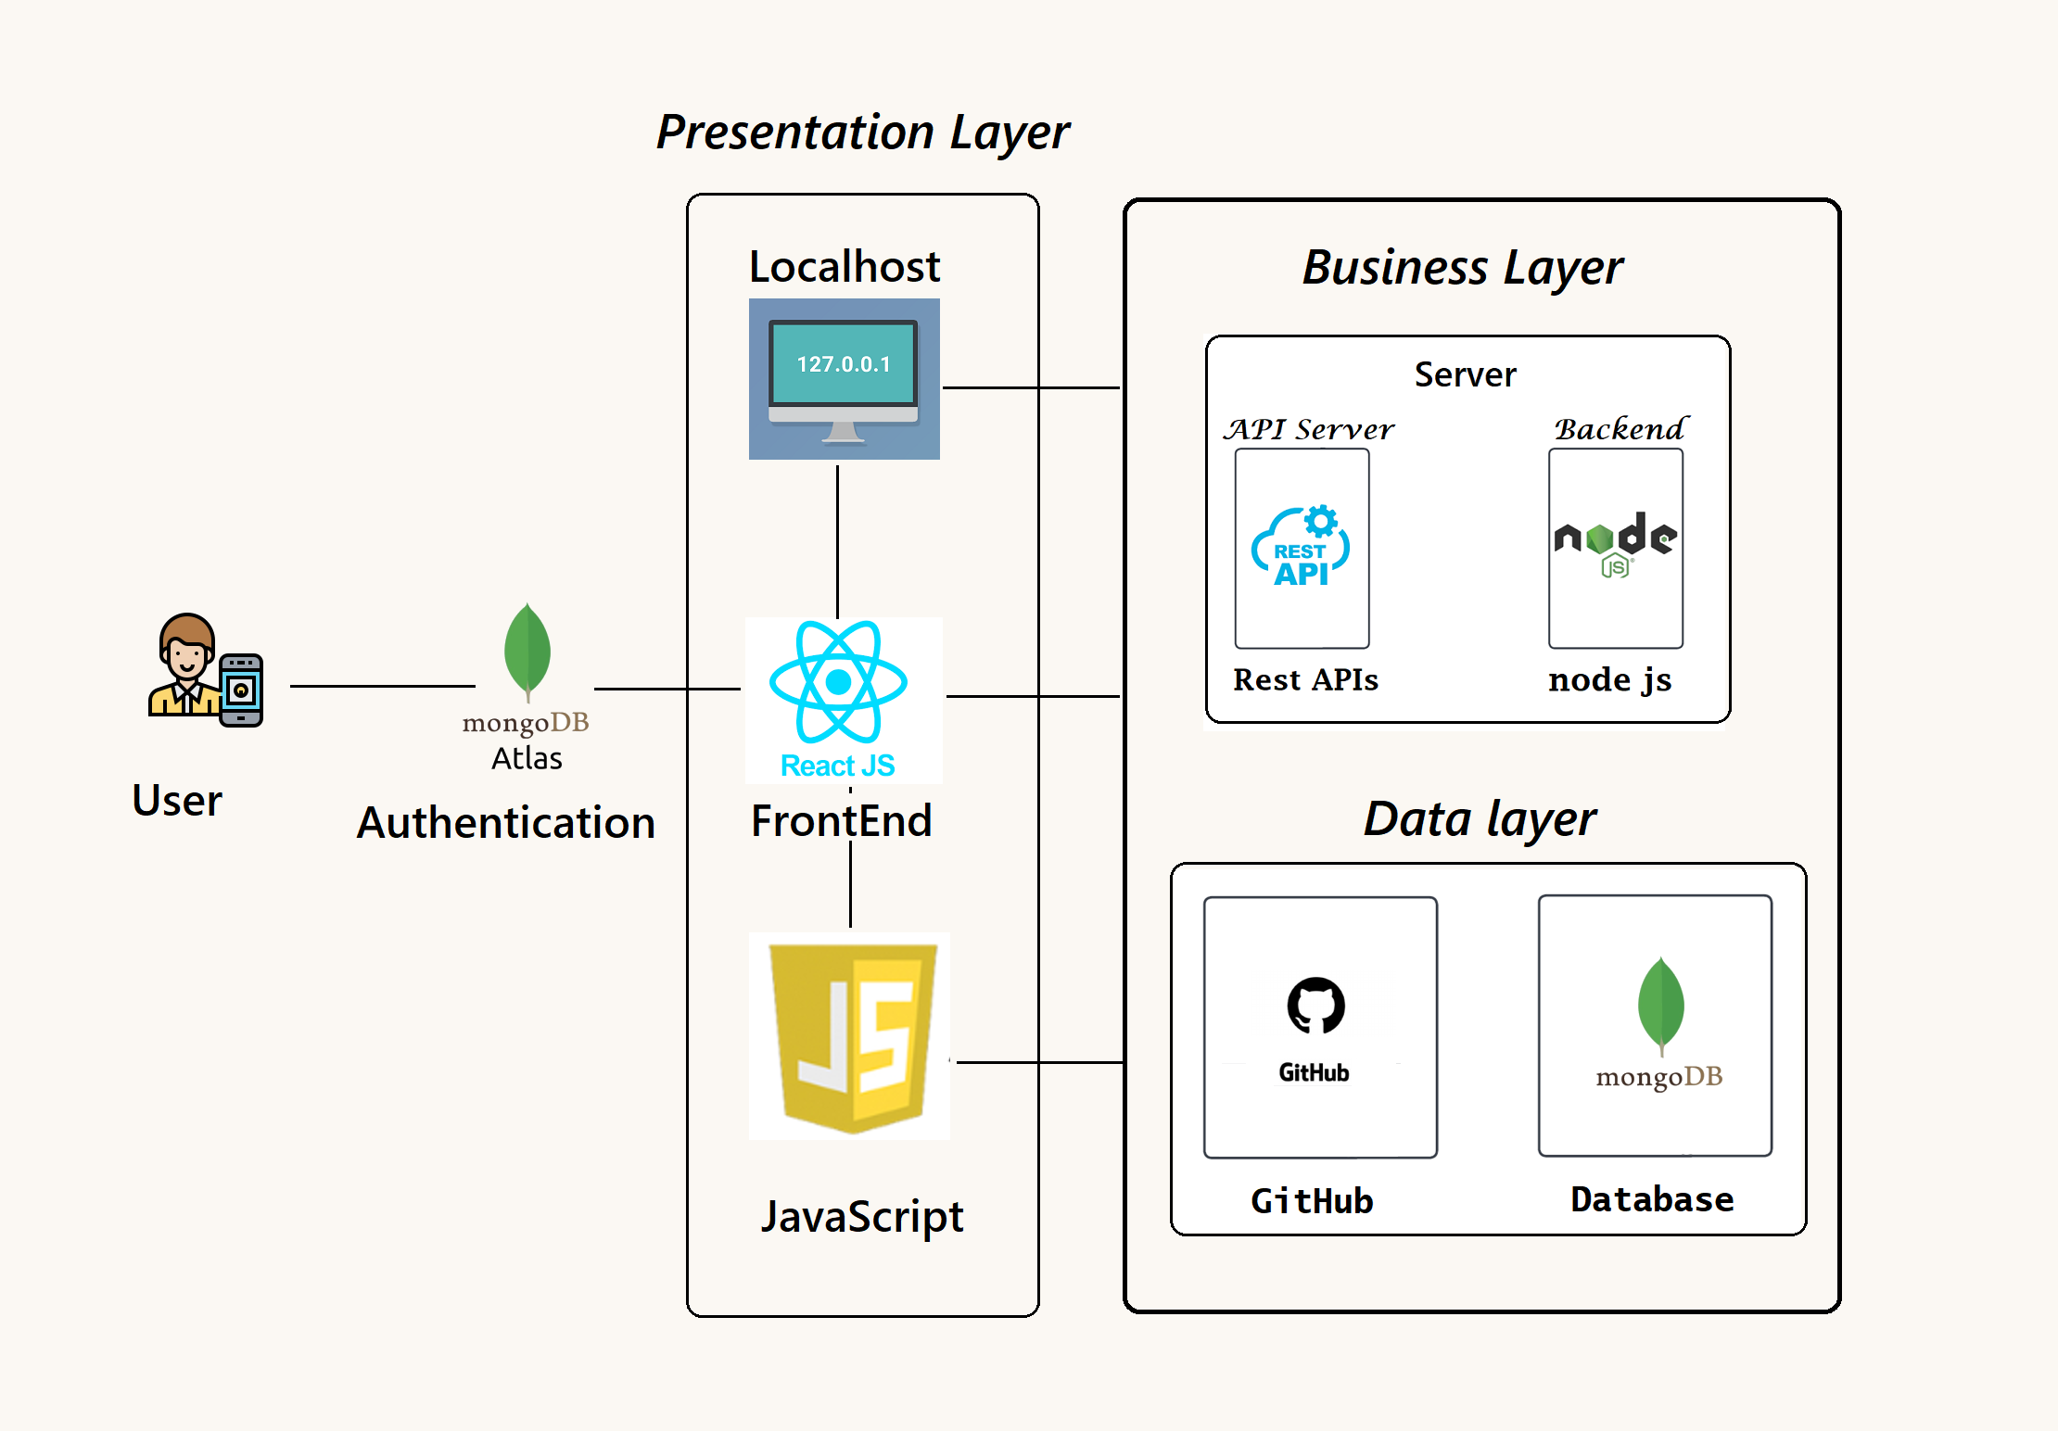
Architectural Diagram

Slide 17
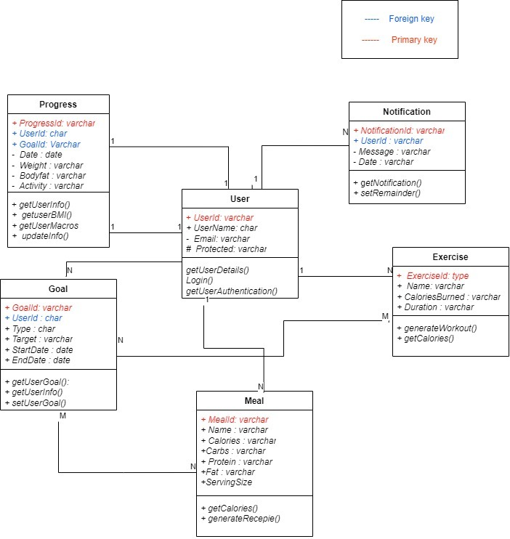
ER Diagram

Slide 18
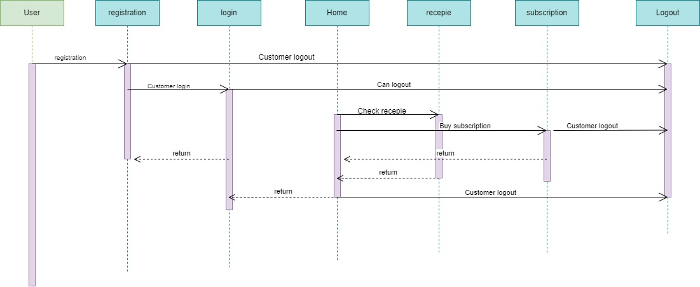
User sequence diagrams

Slide 19
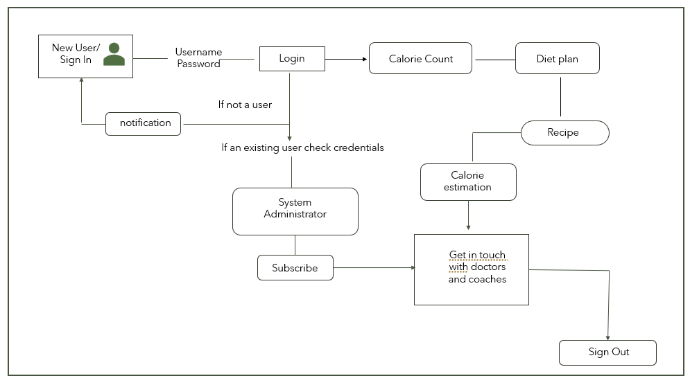
Data Flow Diagram

Slide 20
Algorithm
Calorie counting is a process where it uses multiple algorithm such as object detection and is linked to a database where the calorie information of each food and ingredients is stored in it. When a user take pictures of their meal, it will detect the food and automatically count the total calories that is about to be consumed for the users. This is applied in many healthy diet applications to help users to keep track of the numbers of calories consumed in the food so that one will not eat too much.
Since healthy diet is popularly concerned in this modern world. These application able to help the individuals to maintain and improve their overall health by providing relevance information such as calories, nutritional facts as well as keeping track of their food intake. One biggest flaws that these applications have made are that they do not have object counting algorithm. This will affect the counting process and will not be able to provide an accurate result during the process. The information are too generalized where the calories are counted in a fixed portion or the user need to manually select their quantities of it, but most of them would not prefer to gone through these hassle. The aim for this project is to further enhance these applications in the form of accuracy in counting food calories by using object detection and object counting so that each of every ingredients and food to be consumed by the user is determined and provide a precise result for them.

Slide 21




Sprint 7 recap
Adding the doctors' details
Added new ids for Sign/Login Page
Added features for the Application
Worked on new user stories
Design backend & working on Database
Changed the UI Background
Added more recipes to the list
Adding the coaches' details
Save the recipes to your favorites

Slide 22


Sprint 7 Vs Sprint 8
Sprint
Sprint
Worked on new features to the application.
Added new story points and specified issues and tasks.
Recipes and recommendation are added according based on maintenance calories.
Adding the coaches and doctors' lists.
Changed the background for user interface.
Added new story points and specified issues and tasks.
Worked on the Deployment Manual.
Updated the tech paper.
Save the recipes to your favorites.
Added membership plan to the application.
Added all the files to the repository.

Slide 23

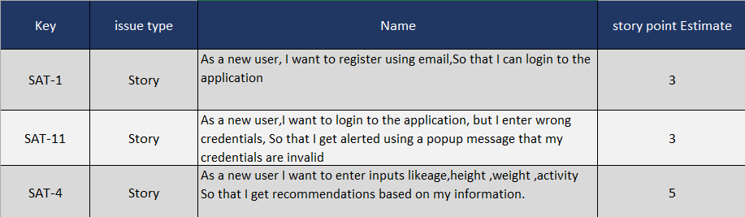
Sprint 2 Backlog

Slide 24
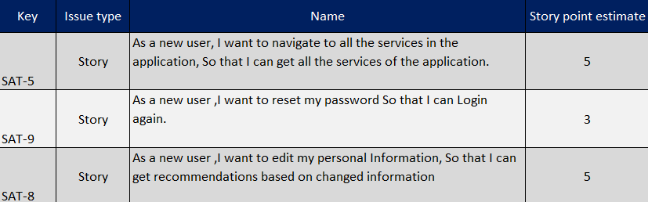
Sprint 3 Backlog

Slide 25
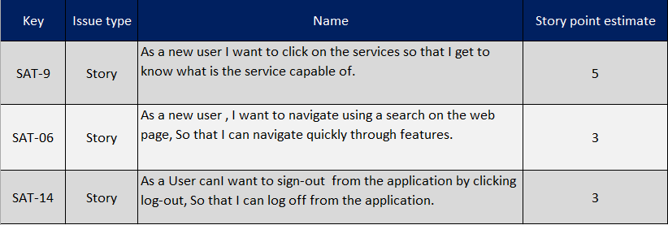
Sprint 4 Backlog

Slide 26
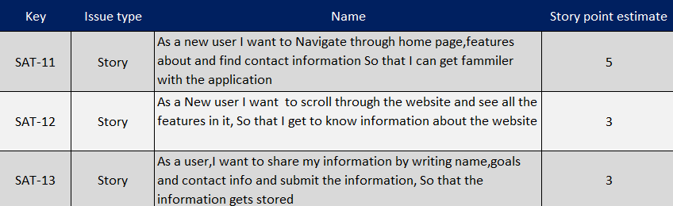
Sprint 5 Backlog

Slide 27
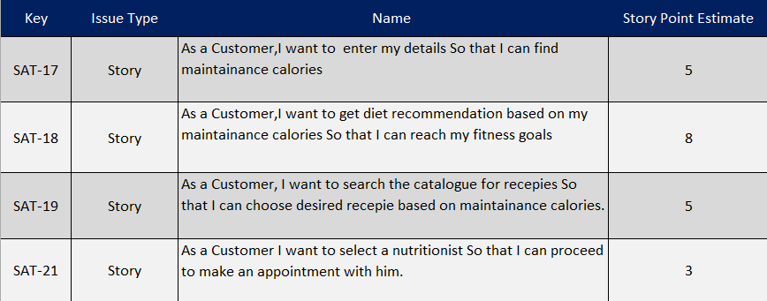
Sprint 6 Backlog

Slide 28
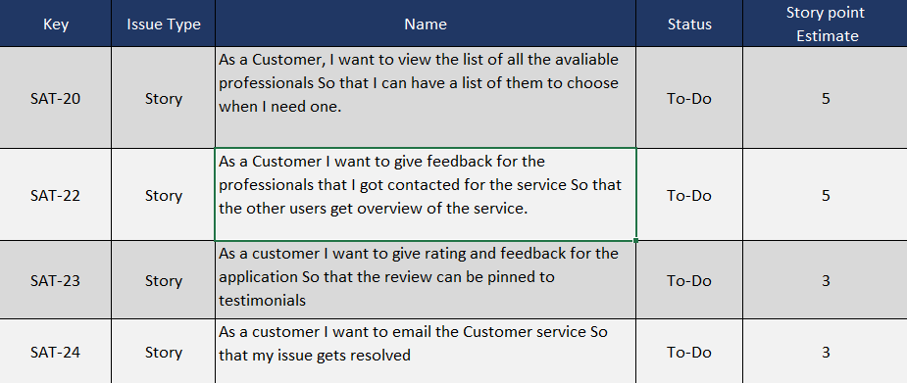
Sprint 7 Backlog

Slide 29
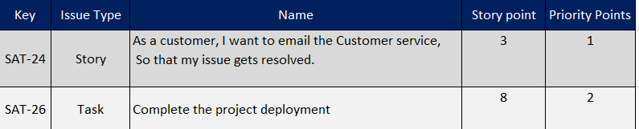
Sprint 8 Backlog

Slide 30
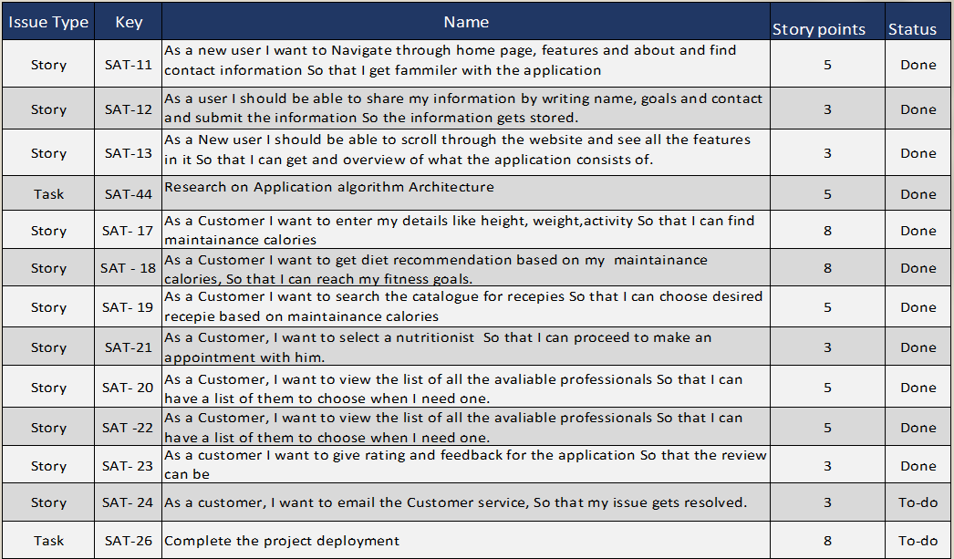
Product Backlog

Slide 31
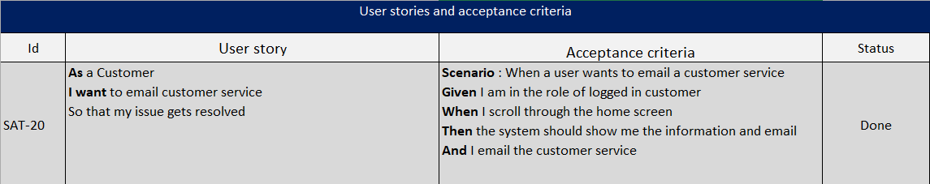
User Stories and Acceptance Criteria

Slide 32
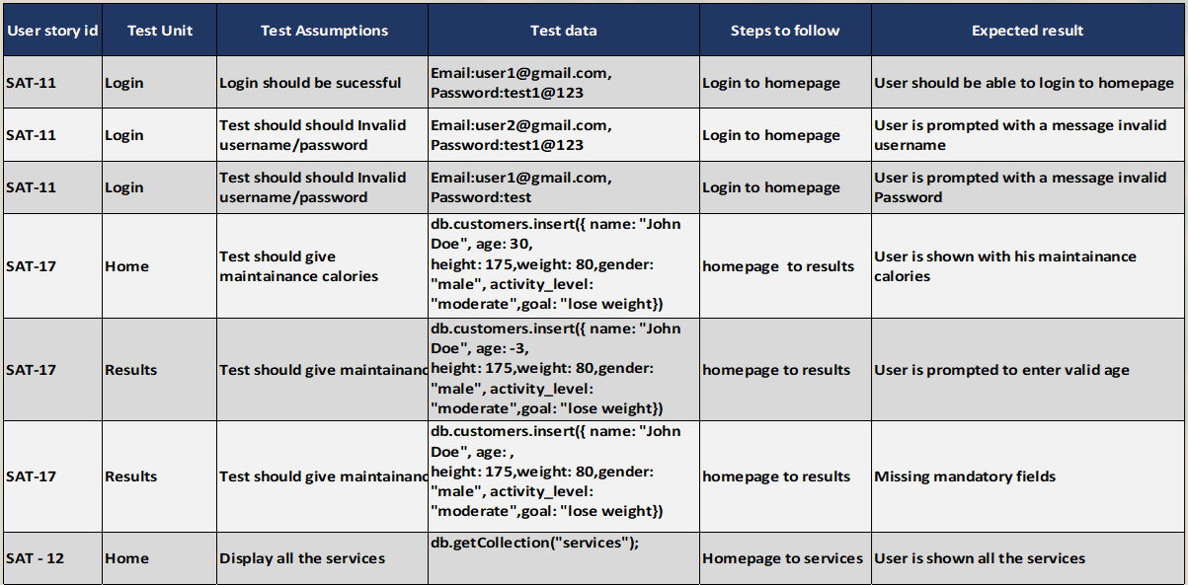
Test Cases

Slide 33
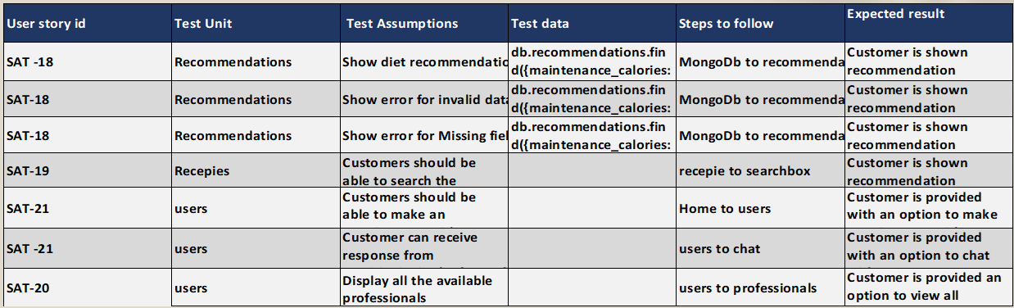
Test Cases

Slide 34
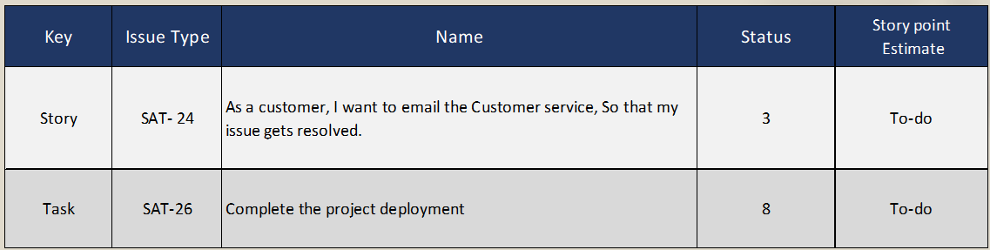
Stories completed for Sprint 8

Slide 35


Metrics

Slide 36
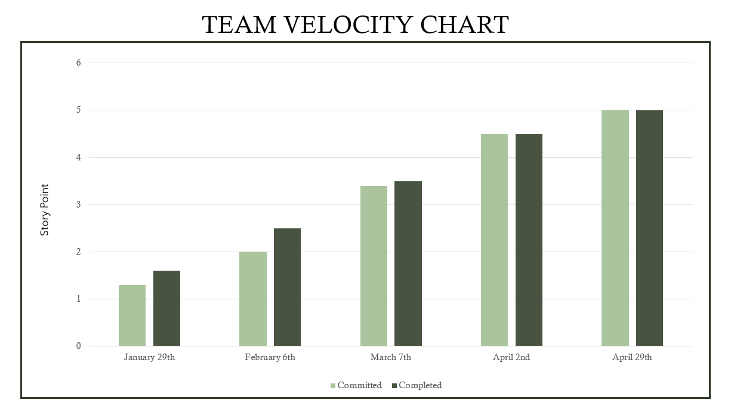

Slide 37
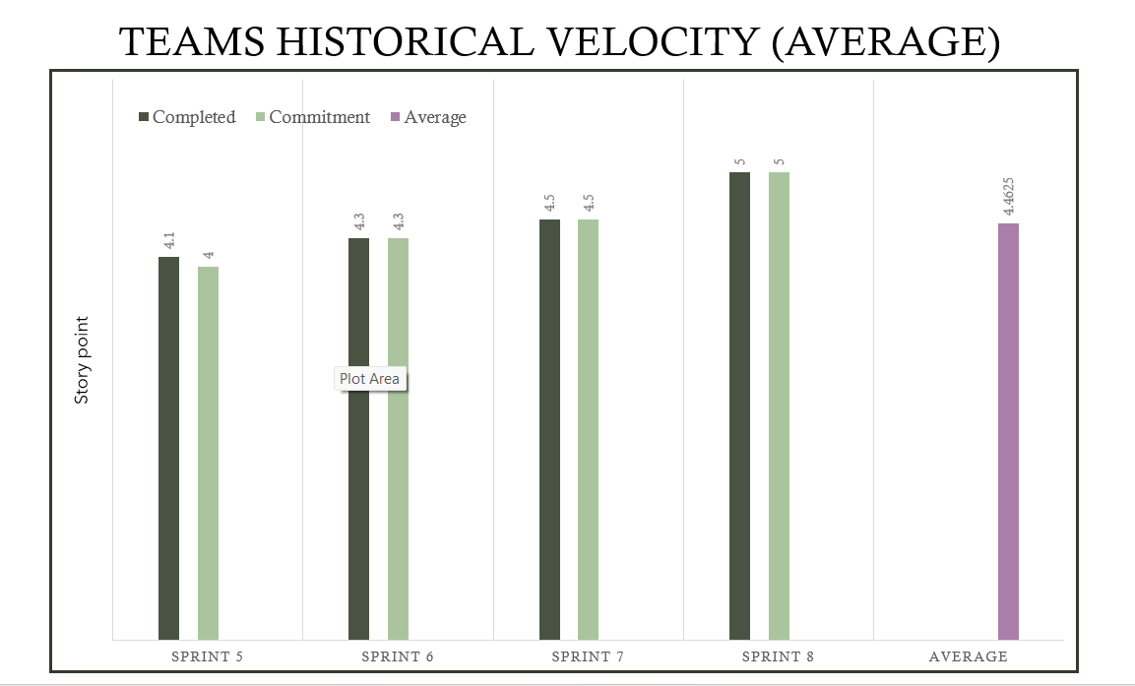

Slide 38
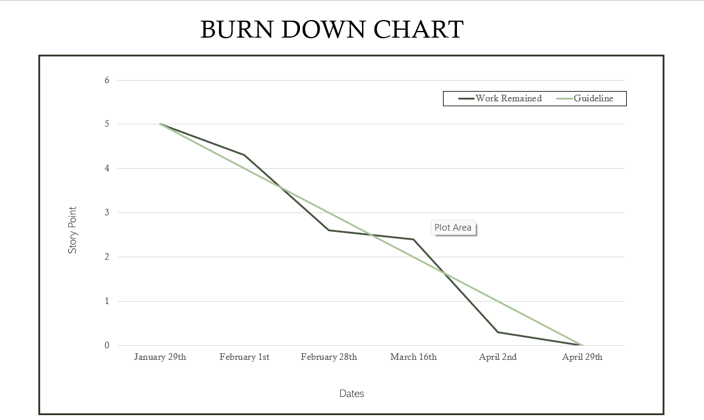

Slide 39
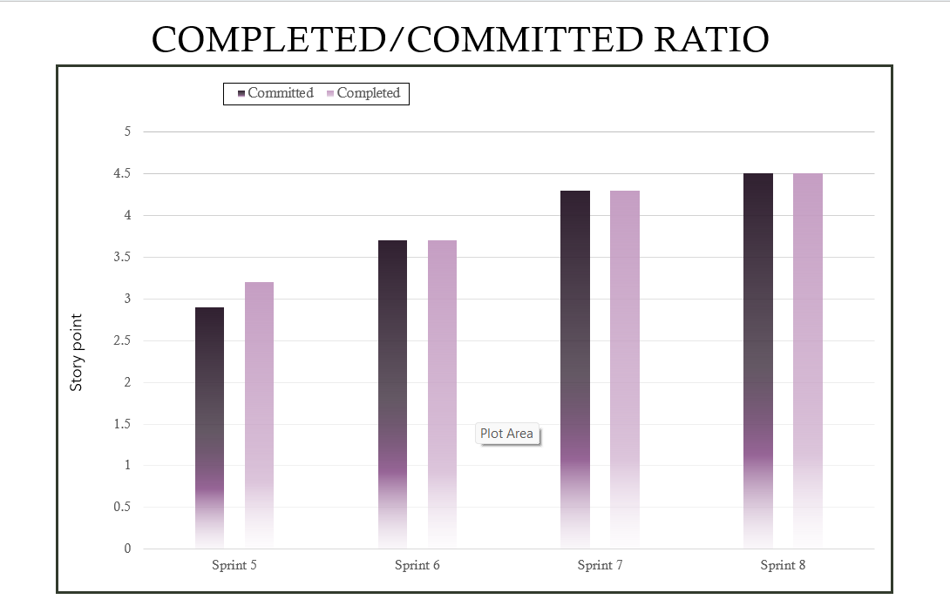

Slide 40

Retrospective

Slide 41









What went well?
Most of the meetings went according to the scheduled manner .
We completed the sprint 7 deliverables on time.
Teammates supported and helped each other to submit deliverables on time
What needs improvement?
Couldn’t be able to conduct required meetings as the teammate were busy with their own schedules
Require more time to work on the new features that are added.
Avoid delaying the work and depending on the other teammates to complete their tasks.
Next steps
Need to improve time-management and spend time to work on the deliverable.
Discuss the new updates about the project and members need to take initiative and work on their part for sprint submission.
Team should focus on timely integration and deployment.

Slide 42

Project Demo

Slide 43
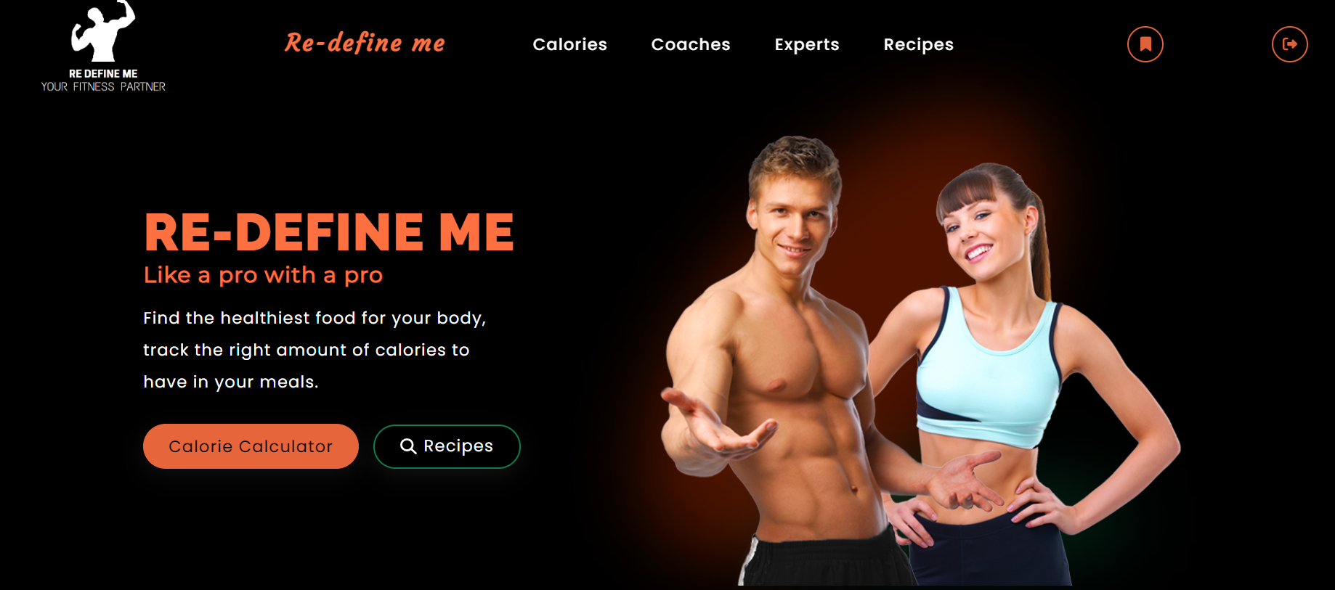
Application Screenshots

Slide 44
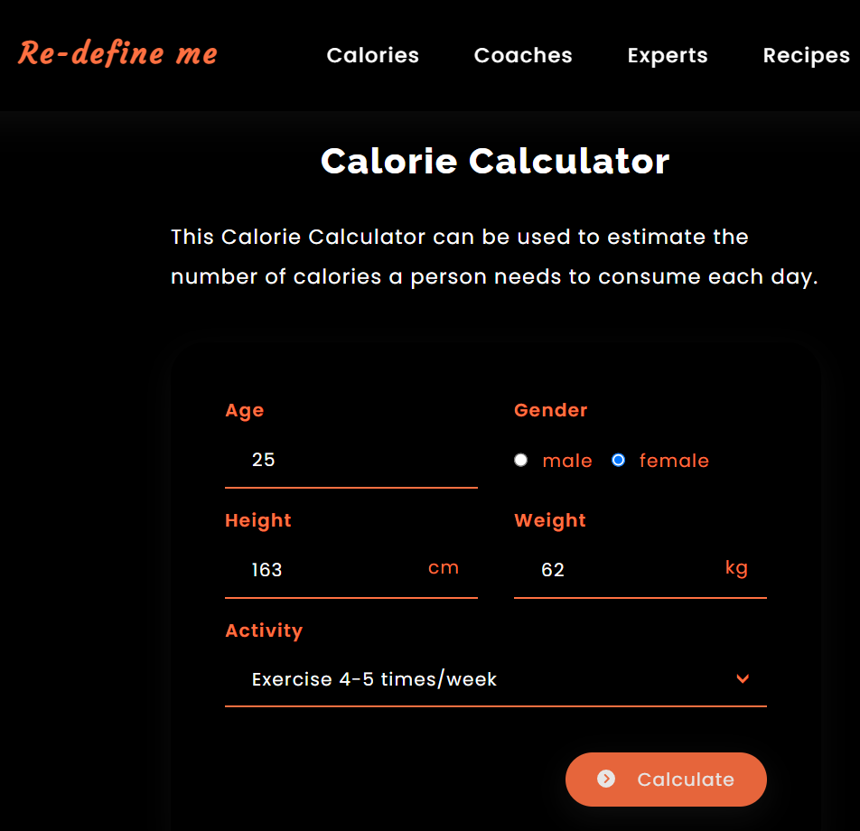
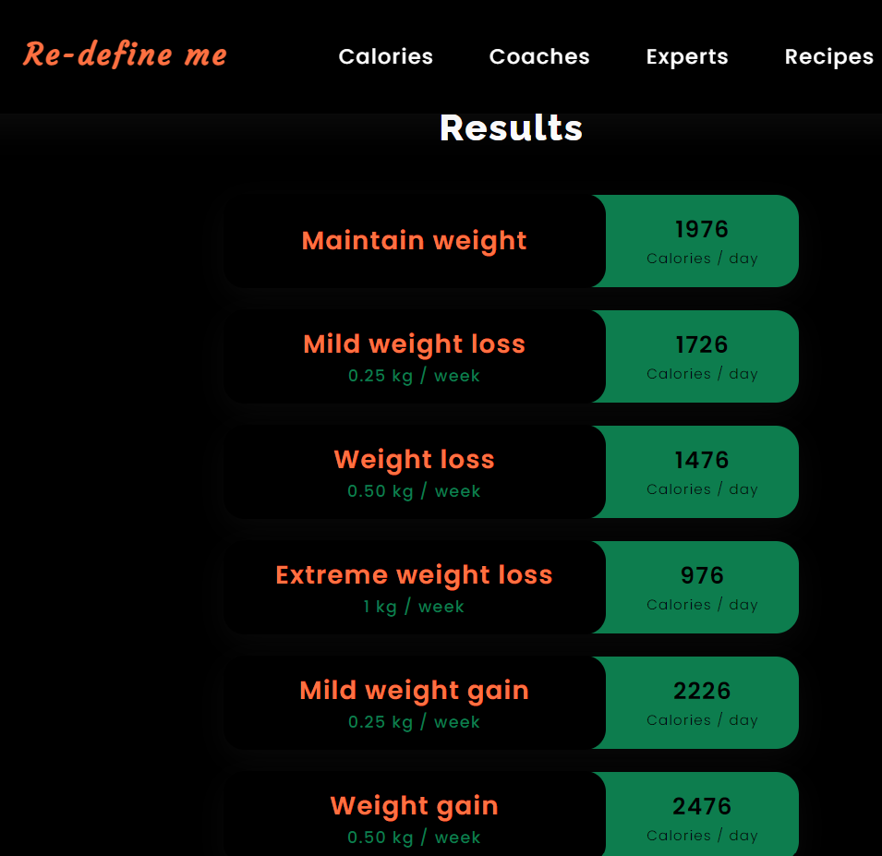
Slides App Screenshot

Slide 45
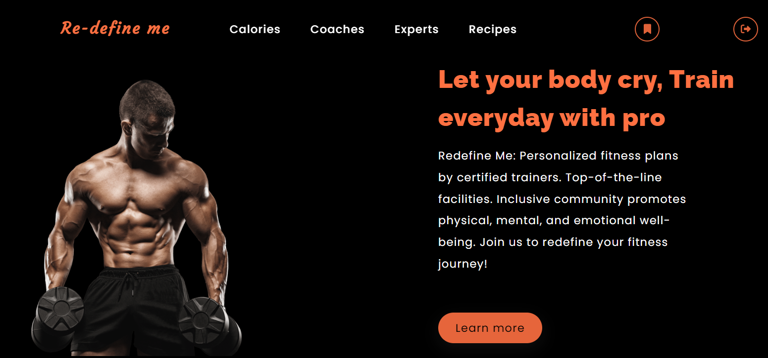
Slides App Screenshot

Slide 46

Slides App Screenshot

Slide 47
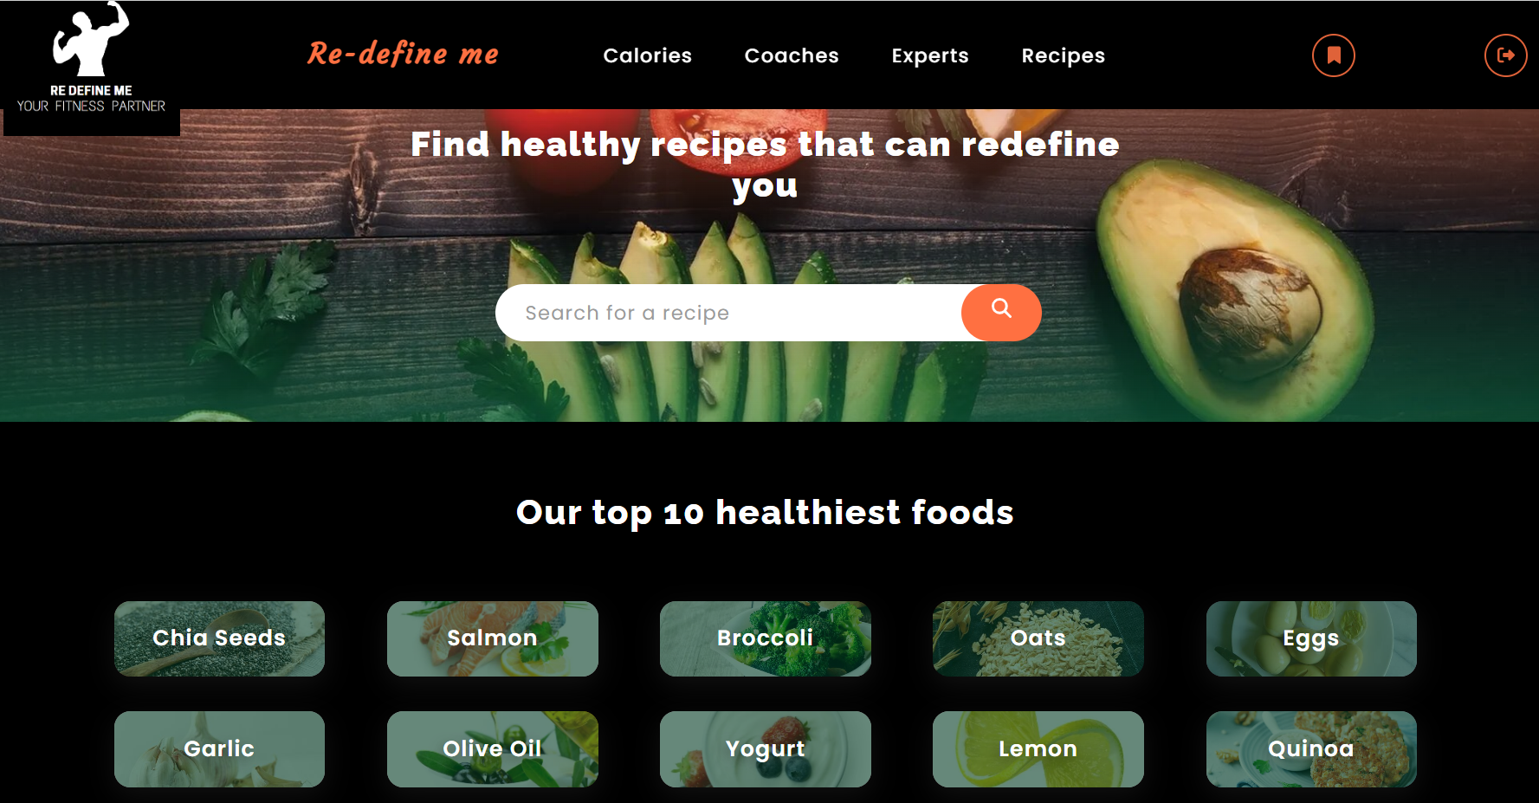
Slides App Screenshot

Slide 48
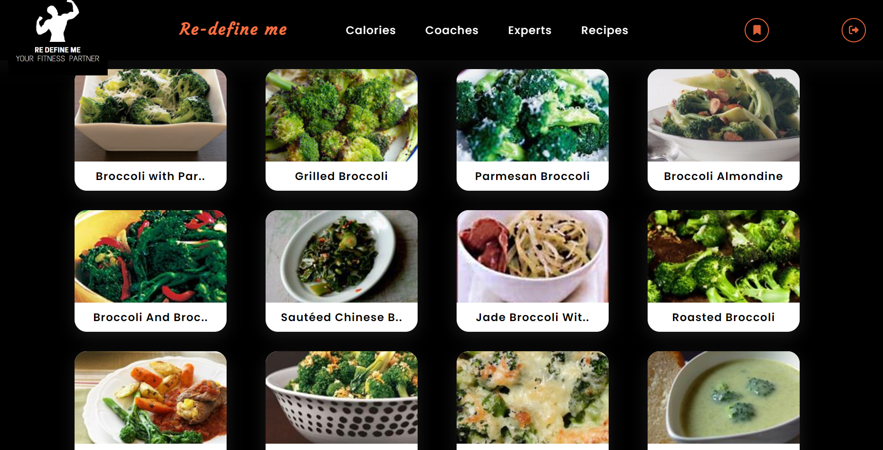
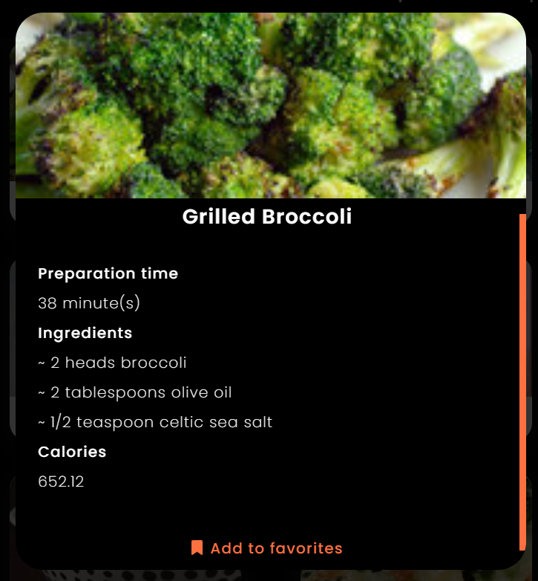
Slides App Screenshot

Slide 49
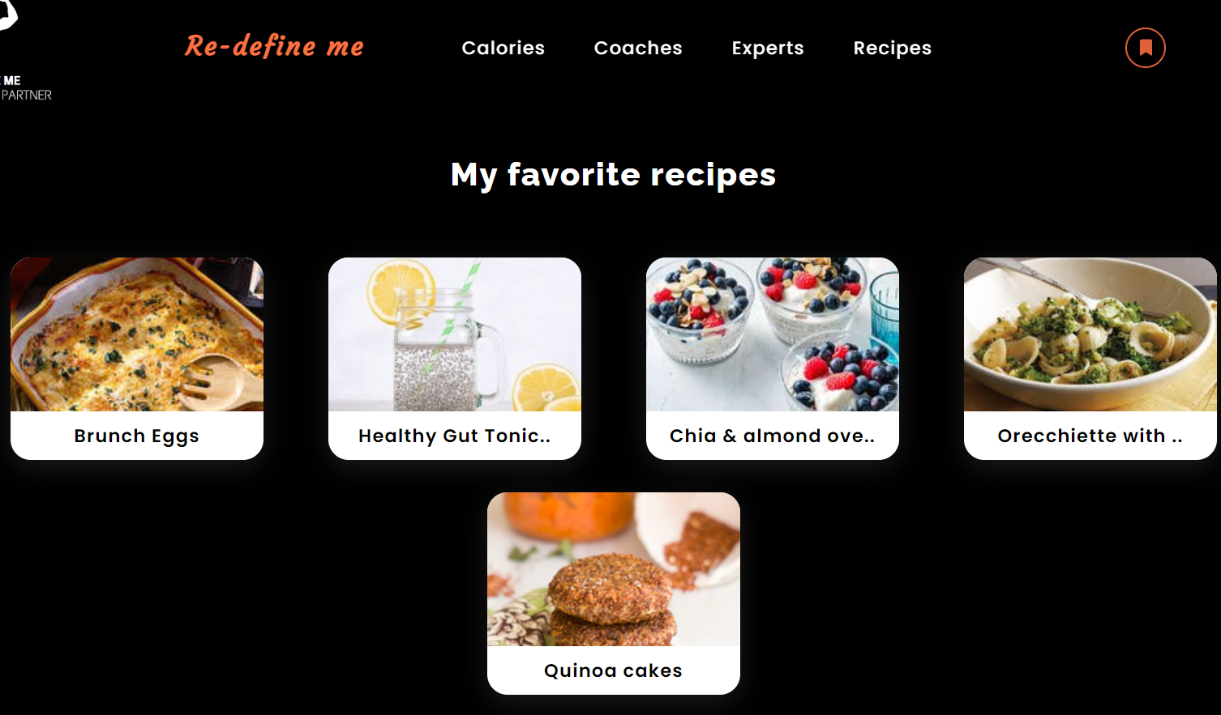
Slides App Screenshot

Slide 50
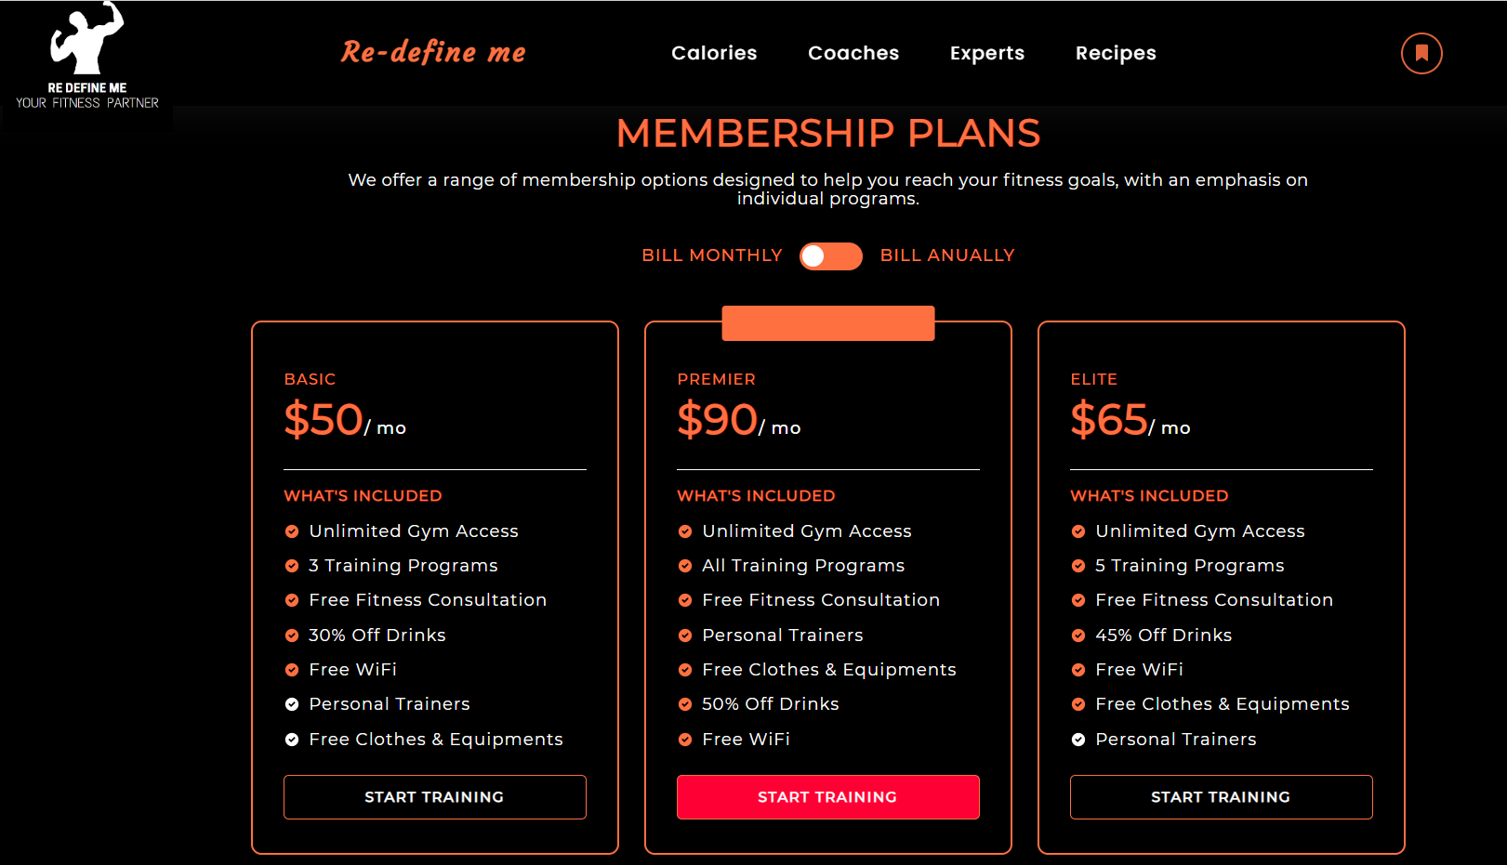
Slides App Screenshot

Slide 51





GitHub Link:
https://github.com/htmw/tiny-coder/wiki
Technical Paper Link:
TEAM 2 TECH PAPER.docx
Presentation Link:
Final Project Re-Define Me.pptx
Presentation Video Link:
https://youtu.be/cVNbxw5cWFs
Presentation Pdf Link:
file:///C:/Users/maana/Downloads/Final%20Project%20Re-Define%20Me.pdf

Slide 52
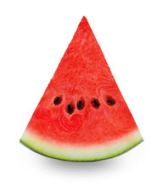











Happy Eating
Tiny-Coders

